Slide 1
TS

Slide 2
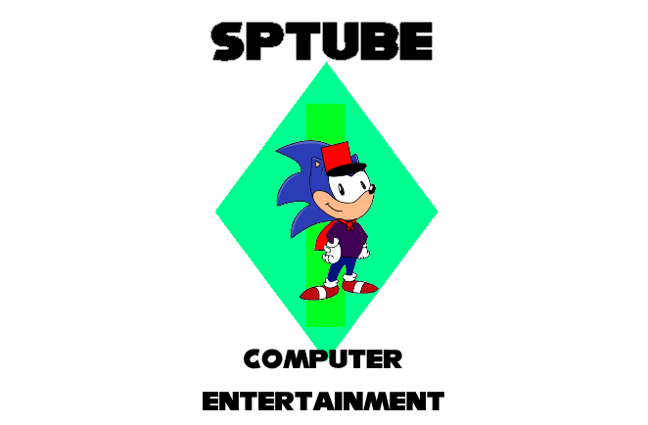

Slide 3
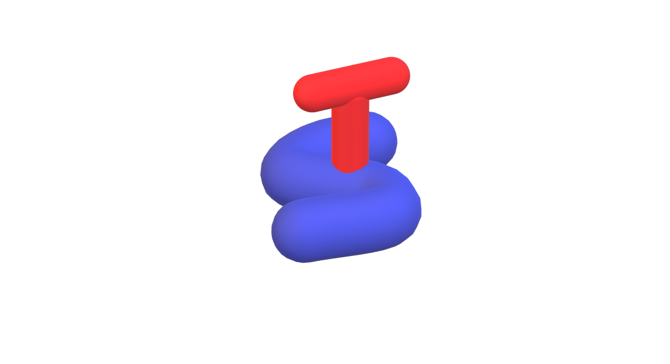

©TrigStation, Triggerworks, SPcorp, iSonic, JSPW (1994 - 1998), all rights reversed.

Slide 4

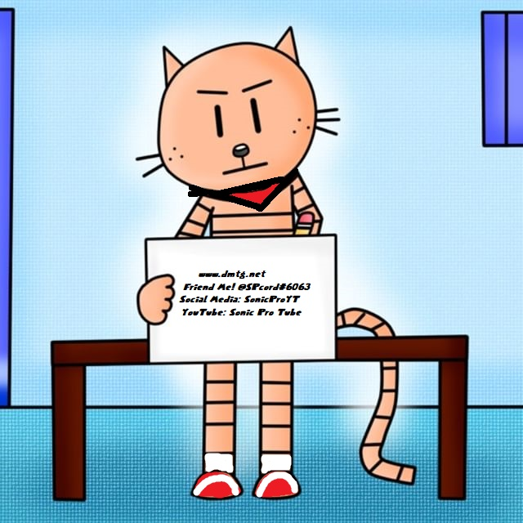
Menu
iSonic OS (TrigStation Reloaded)
Play Sonic Pro & Cappy
Play Sonic Pro Odyssey

